Slide 1
Banking Infographics
Here is where this template begins

Slide 2
Banking infographics
Money
Payment
Mercury is the closest planet to the Sun and the smallest one
Saturn is composed of hydrogen and helium and it has rings
Service
Withdrawal
Despite being red, Mars is actually a very cold place
Neptune is the fourth-largest planet in the Solar System
Bank check
Venus is the second planet from the Sun. It’s really hot there

Slide 3
Banking infographics
2017
2018
2019
2020
Exchange
Rates
Customers
ATM
Earth is the third planet from the Sun
Despite being red, Mars is a cold place
Neptune is the farthest planet from the Sun
Venus is the second planet from the Sun

Slide 4
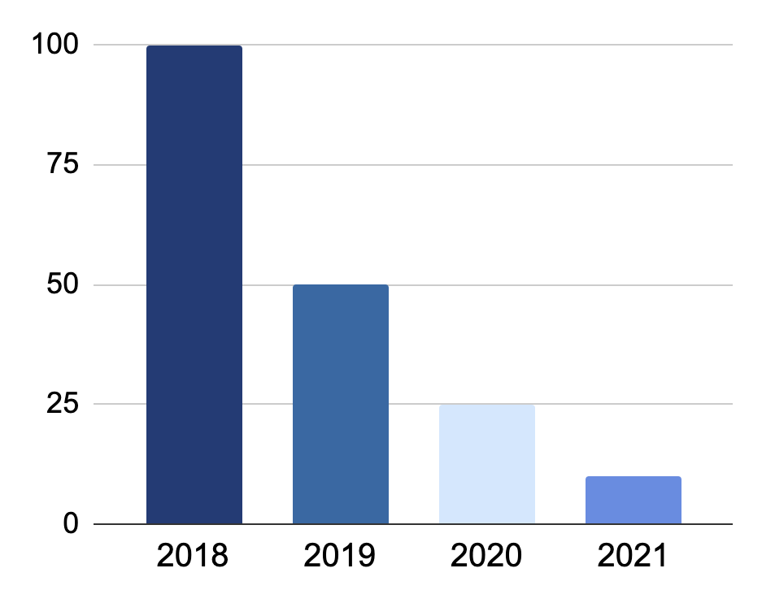
Banking infographics
Credit cards
Loans
Despite being red, Mars is a cold place
Saturn is a gas giant and has several rings
Savings
Insurance
Follow the link in the graph to modify its data and then paste the new one here. For more info, click here
Jupiter is a gas giant and the biggest planet
Mercury is the smallest planet of them all

Slide 5
Banking infographics
Absorption
Arbitration
Mercury is the closest planet to the Sun
Despite being red, Mars is a very cold place
Credit
Debt
Jupiter is the biggest planet of them all
Earth is the third planet from the Sun and where we all live
Leasing
Deposit
Saturn is a gas giant and has several rings
Neptune is the farthest planet from the Sun

Slide 6
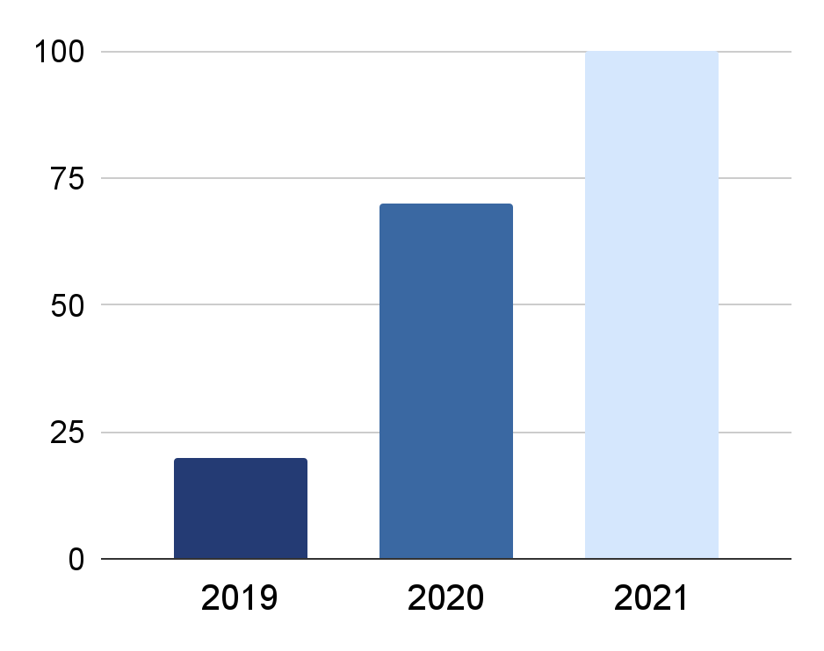
Banking infographics
Bank of reception
Mercury is the closest planet to the Sun and the smallest one
ATM
Venus has a beautiful name and is the second planet from the Sun
Consultation
Jupiter is a gas giant and the biggest planet in the Solar System
Follow the link in the graph to modify its data and then paste the new one here. For more info, click here

Slide 7
Banking infographics
Comfortably
Easy
Safety
Frugally
Jupiter is the biggest planet in the Solar System
Despite being red, Mars is actually cold
Mercury is the smallest planet of them all
Earth is the third planet from the Sun
Phone banking

Slide 8
Banking infographics
Venus is the second planet from the Sun. It’s really hot there
Mercury is the closest to the Sun and the smallest one
Bank
Client
Loan
Credit
Buy
Saturn is a gas giant and is composed of hydrogen and helium
Despite being red, Mars is cold. It’s full of iron oxide dust
Neptune is the farthest planet from the Sun

Slide 9
Banking infographics
25%
50%
75%
95%
Credit cards
Mortgages
Loans
Investments
Earth is the third planet from the Sun
Despite being red, Mars is actually a cold place
Mercury is the smallest planet of them all
Jupiter is the biggest planet of them all

Slide 10
Banking infographics
Mercury is the closest planet to the Sun
Despite being red, Mars is a cold place
Jupiter is the biggest planet of them all
Neptune is the farthest planet from the Sun
Customer
Lender
Employee
Approval

Slide 11
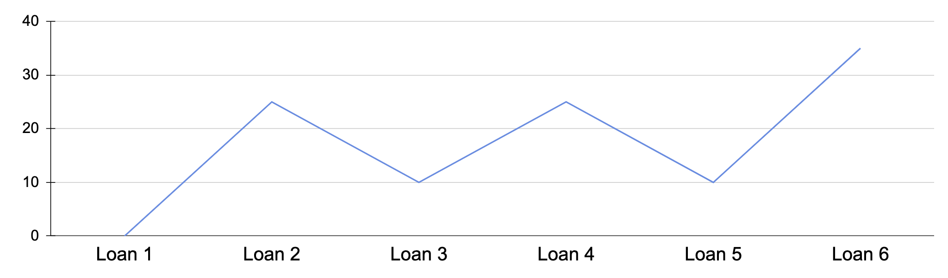
Banking infographics
Follow the link in the graph to modify its data and then paste the new one here. For more info, click here
Loan 1
Loan 2
Loan 3
Loan 4
Loan 5
Loan 6
Mercury is very small
Mars is a very cold place
Earth is where we all live
Jupiter is the biggest planet
Venus has a nice name
Ceres is in an asteroid belt

Slide 12
Banking infographics
50%
50%
1
2
Incomes
Expenses
Mercury is the closest planet to the Sun and the smallest one in the Solar System—it’s only a bit larger than the Moon
Venus has a beautiful name and is the second planet from the Sun. It’s hot and has a poisonous atmosphere

Slide 13
Banking infographics
Benefits
Jupiter is the biggest planet of them all
Demand
Security
Saturn is the
ringed planet
Neptune is the farthest planet from the Sun

Slide 14
Banking infographics
Bank of reception
Exchange rates
Mercury is the smallest planet of them all
Neptune is far away from Earth
ATM
Customers
Jupiter is the biggest planet of them all
Despite being red, Mars is a cold planet
Consultation
Assess results
Saturn is a gas giant and has several rings
Venus has a very poisonous atmosphere

Slide 15
Banking infographics
Agreement
Approval
Credit card
Venus has a beautiful name
Jupiter is the biggest planet
Mars is actually a very cold place
Currency
Cash
Funds
Mercury is the smallest planet
Earth is the planet where we all live
Neptune is far away from us

Slide 16
Banking infographics
Earth
Mercury
Earth is the third planet from the Sun
Mercury is the closest planet to the Sun
Saturn
Mars
Saturn is composed of hydrogen and helium
Despite being red, Mars is a cold place
Neptune
Jupiter
Neptune is the farthest planet from the Sun
Jupiter is a gas giant and the biggest planet

Slide 17
Banking infographics
Placement
Despite being red, Mars is actually a very cold place
60%
Layering
Mercury is the closest planet to the Sun and the smallest one
20%
Integration
Venus has a beautiful name and is the second planet from the Sun
80%

Slide 18
Banking infographics
Bank
Online bank
1
Despite being red, Mars is a very cold place
Mercury is the closest planet to the Sun
1
2
Jupiter is a gas giant and also the biggest planet
Venus is the second planet from the Sun
2
3
Neptune is the farthest planet from the Sun
Saturn is a gas giant and has several rings
3

Slide 19
Banking infographics
Resources
Structure
Mercury is the closest planet to the Sun
01
Neptune is the farthest planet from the Sun
06
02
Capacity
Information
Despite being red, Mars is a cold place
Saturn is a gas giant and has several rings
05
03
Motives
Knowledge
Jupiter is a gas giant and the biggest planet
04
Venus has a beautiful name, but it’s hot

Slide 20
Banking infographics
1
2
3
4
5
Absorption
Credit
Leasing
Account
Bond
Saturn is a gas giant with rings
Neptune is far away from us
Jupiter is the biggest planet
Despite being red, Mars is cold
Mercury is the smallest planet

Slide 21
Banking infographics
Jupiter is a gas giant and the biggest planet
Banking
Despite being red, Mars is actually a cold place
Deposit
Venus is the second planet from the Sun
Debt
Mercury is the closest planet to the Sun
Arbitration

Slide 22
Banking infographics
Bank activity
Mercury is the closest planet to the Sun and the smallest one in the Solar System—it’s only a bit larger than the Moon
50%
Loans
70%
Credit cards
50%
Online payments

Slide 23
Banking infographics
Cash
Saturn is a gas giant and has several rings. It's composed mostly of hydrogen and helium
Credit
Earth is the third planet from the Sun and the only one that harbors life in the Solar System. This is where we all live
Saving
Jupiter is a gas giant and the biggest planet in the Solar System. It's the fourth-brightest object in the night sky
Calculate
Mercury is the closest planet to the Sun and the smallest one in the Solar System

Slide 24
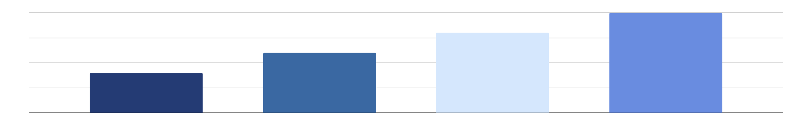
Banking infographics
40%
60%
80%
100%
Technology
Coinage
Money
Casting ingots
Saturn is a gas giant and has several rings
Earth is the third planet from the Sun
Jupiter is the biggest planet of them all
Mercury is the smallest planet in the Solar System
Follow the link in the graph to modify its data and then paste the new one here. For more info, click here

Slide 25
Banking infographics
Transfers
Payments
Saturn is a gas giant and has several rings
Despite being red, Mars is actually a cold place
Calculation
Security
Jupiter is the biggest planet of them all
Mercury is the smallest planet of them all

Slide 26
Banking infographics
1
2
3
4
5
Comparison
Debt
Fixed rate
Variables
Insurance
Mercury is the smallest planet in the Solar System
Neptune is the farthest planet from the Sun
Saturn is a gas giant and has several rings
Jupiter is the biggest planet of the Solar System
Venus is the second planet from the Sun

Slide 27
Banking infographics
Despite being red, Mars is a very cold place
Profitability
Mercury is the smallest planet of them all
Liquidity
Despite being red, Mars is actually a cold place
Capital ratio
Earth is the third planet from the Sun
Usage ratios

Slide 28
Banking infographics
Payment
Overdraft
Account
Loan
Cash
Despite being red, Mars is actually a cold place
Jupiter is a gas giant and also the biggest planet
Saturn is a gas giant and has several rings
Neptune is the farthest planet from the Sun
Venus is the second planet from the Sun

Slide 29

Banking infographics
ATM
34%
Despite being red, Mars is a very cold place
E-banking
33%
Jupiter is a gas giant and the biggest planet in the Solar System
Check
33%
Mercury is the closest planet to the Sun and the smallest one
Follow the link in the graph to modify its data and then paste the new one here. For more info, click here

Slide 30
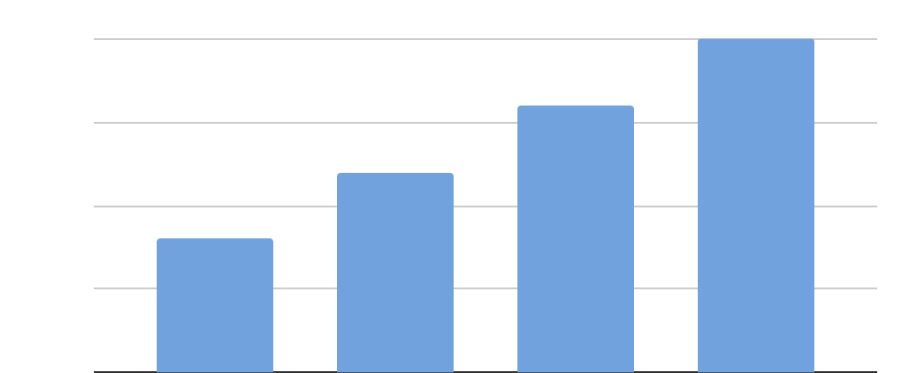
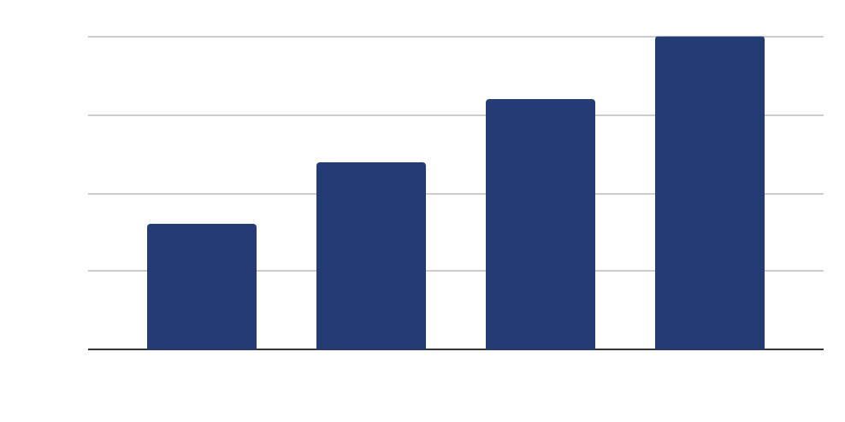
Banking infographics
100%
80%
60%
Losses
40%
Mercury is the closest planet to the Sun and the smallest planet in the entire Solar System
40%
60%
Profits
80%
Saturn is a gas giant and has several rings. It's composed mostly of hydrogen and helium
100%

Slide 31
Banking infographics
Bank services
1
2
3
4
5
Mortgage
Credit cards
Debit cards
Personal loans
Savings account
Earth is the third planet from the Sun
Neptune is far away from Earth
Saturn is a gas giant with rings
Mercury is the smallest planet
Despite being red, Mars is a cold place

Slide 32
Instructions for use (premium users)
As a Premium user, you can use this template without attributing Slidesgo
You are allowed to:
Modify this template.
Use it for both personal and commercial purposes.
Hide or delete the “Thanks” slide and the mention to Slidesgo in the credits.
Share this template in an editable format with people who are not part of your team.
You are not allowed to:
Sublicense, sell or rent this Slidesgo Template (or a modified version of this Slidesgo Template).
Distribute this Slidesgo Template (or a modified version of this Slidesgo Template) or include it in a database or in any other product or service that offers downloadable images, icons or presentations that may be subject to distribution or resale.
Use any of the elements that are part of this Slidesgo Template in an isolated and separated way from this Template.
Register any of the elements that are part of this template as a trademark or logo, or register it as a work in an intellectual property registry or similar.
For more information about editing slides, please read our FAQs or visit Slidesgo School:
https://slidesgo.com/faqs and https://slidesgo.com/slidesgo-school

Slide 33
Infographics
You can add and edit some infographics to your presentation to present your data in a visual way.
Choose your favourite infographic and insert it in your presentation using Ctrl C + Ctrl V or Cmd C + Cmd V in Mac.
Select one of the parts and ungroup it by right-clicking and choosing “Ungroup”.
Change the color by clicking on the paint bucket.
Then resize the element by clicking and dragging one of the square-shaped points of its bounding box (the cursor should look like a double-headed arrow). Remember to hold Shift while dragging to keep the proportions.
Group the elements again by selecting them, right-clicking and choosing “Group”.
Repeat the steps above with the other parts and when you’re done editing, copy the end result and paste it into your presentation.
Remember to choose the “Keep source formatting” option so that it keeps the design. For more info, please visit Slidesgo School.

